Slide 1
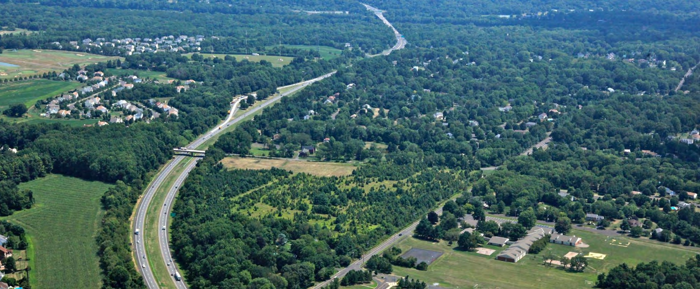




Delaware River Joint Toll Bridge Commission
April 27, 2016
Lower Makefield Township Community Meeting
Scudder Falls Bridge Replacement Project

Slide 2

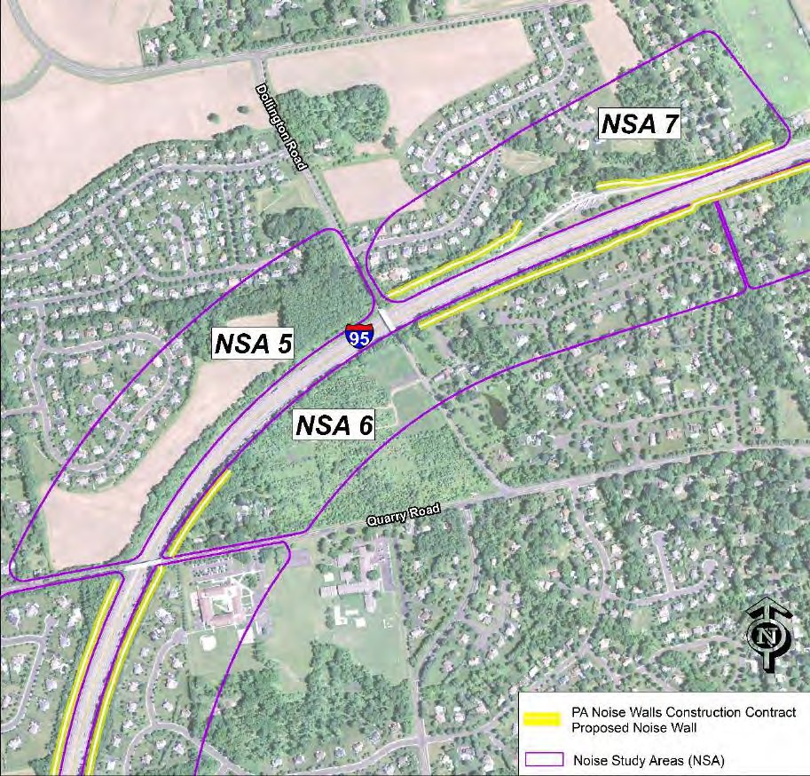
Introduction
Lower Makefield Township Community Meeting
A Supplemental Noise Analysis Study was performed in January 2016 for Noise Study Areas (NSA) 5, 6 and 7 based on public comments and input received during the December 3, 2015 public meeting.

Slide 3
Introduction
Lower Makefield Township Community Meeting
Noise Study Areas (NSA) Neighborhoods
NSA 5: Makefield Brook, Makefield Brook II,
and Fairfield at Farmview
NSA 6: Snipes Tract (I-95 and Quarry Road)
NSA 7: Longshore Estates

Slide 4
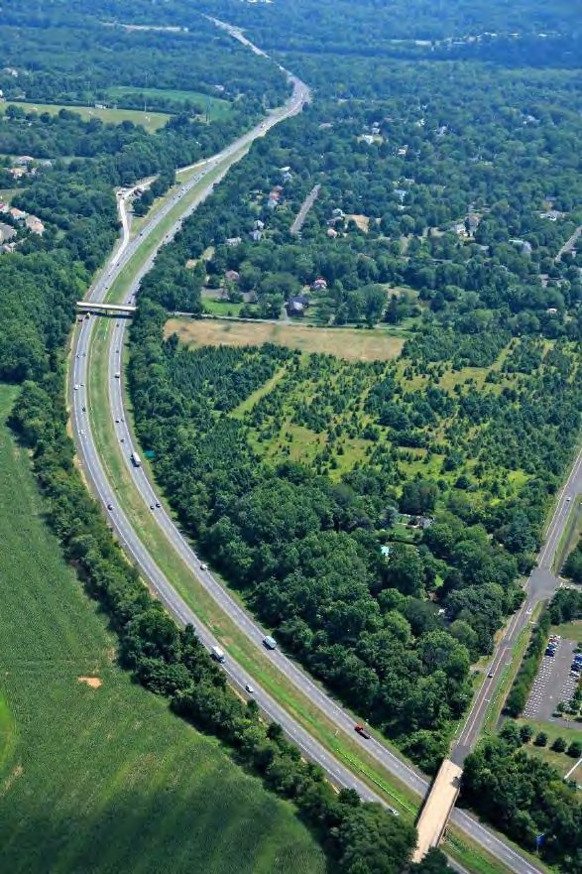
Presentation Overview
Lower Makefield Township Community Meeting
Regulatory Requirements
Typical Noise Analysis Methodology
Impact and Abatement Criteria
Analysis Performed to Date
Results of New Noise Analysis
Conclusions
Questions and Answers

Slide 5
Regulatory Requirements
Lower Makefield Township Community Meeting
A Type I Highway Noise Analysis is required when capacity is added.
The proposed Scudder Falls project is adding through lanes; therefore it is
considered to be a capacity-adding project.
The analysis is governed by Procedures for Abatement of Highway Traffic Noise and Construction Noise (Federal Regulation 23 CFR 772).
For PennDOT projects, analysis guidance is provided in PennDOT Publication No. 24,
Project Level Highway Traffic Noise Handbook.
Bi-state self-supporting agencies (like the DRJTBC) can follow the federal or state regulations and/or have their own policies.

Slide 6
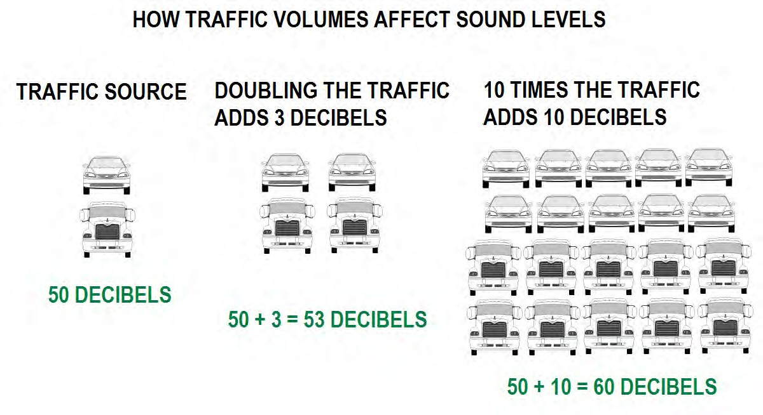
Lower Makefield Township Community Meeting

Slide 7
Lower Makefield Township Community Meeting
Typical Noise Analysis Methodology
Below are the typical steps for evaluating highway noise impacts:
Identify land uses-residential, parks, schools, churches, etc.
Perform short-term and/or long-term noise monitoring to validate the computer model. Using future traffic peak hour volumes, predict the design year (2030) sound levels using the FHWA approved TNM 2.5 computer model and identify the impacted sites.
Determine if the abatement meets criteria for impacted sites.

Slide 8
Impact Criteria
Lower Makefield Township Community Meeting
If the design year sound level is predicted to meet or exceed 66 decibels (dBA) as averaged during the peak period for noise, then the site is impacted and abatement is considered.
The peak period sound level is based on the computer modeled design year traffic
volumes with the construction of the proposed build alternative.
The Impact Criteria is the same for FHWA, PennDOT and the DRJTBC, but the Abatement Criteria is different.

Slide 9
Lower Makefield Township Community Meeting
Abatement Criteria
The Feasibility and Reasonableness Abatement Criteria to construct noise walls is different for FHWA/PennDOT and the DRJTBC.
For FHWA/PennDOT projects:
A minimum 5 dBA reduction is required for the majority (50⁺ %) of the impacted sites
with at least one site receiving 7 dBA reduction.
A maximum “Square Footage [of noise barrier] Per Benefited Receptor” of 2,000
SF/BR cannot be exceeded.

Slide 10
Abatement Criteria
Lower Makefield Township Community Meeting
In response to public input, the feasibility and reasonableness criteria was upgraded by the DRJTBC to provide additional abatement.
For the Scudder Falls Bridge Project:
A minimum 5 dBA reduction was analyzed for the majority (50⁺ %) of the front row impacted sites.
The previous cost reasonableness (SF/BR) criteria was waived.

Slide 11
Lower Makefield Township Community Meeting
Analysis Performed in Relation to NSAs 5, 6 and 7
2009 Environmental Assessment Technical Memo:
Project wide, 57 measurements were performed.
Recommended noise walls for construction in NSA 6 and NSA 7 for impacted sites.
No noise impacts were predicted in NSA 5.

Slide 12
New Analysis Performed at NSAs 5, 6 and 7
Lower Makefield Township Community Meeting
In response to public concern received during the December 3, 2015 Open House, the DRJTBC collected new noise measurements and performed analysis in January 2016 for the following NSAs:
NSA 5: Determine if there are new impacts and recommend abatement, if necessary.
NSA 6: Determine if there are new impacts along the north side of Quarry Road and if so,
determine if the proposed noise wall should be lengthen to the east.
NSA 7: Determine if there are new impacts along Pownal Drive and Bartlett Court and if so, determine if the “gap” between the recommended barriers near the PennDOT rest stop should be closed.

Slide 13
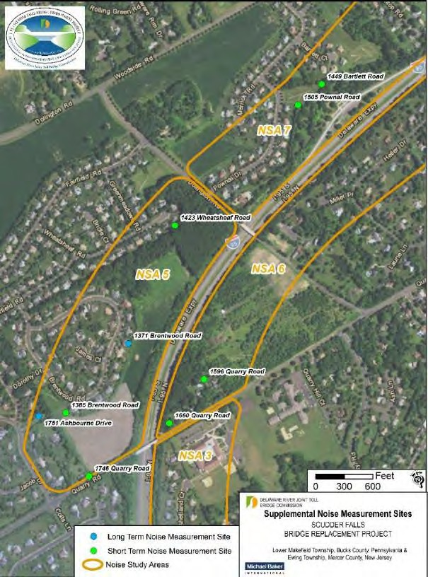
New Analysis Performed at NSAs 5, 6 and 7
Lower Makefield Township Community Meeting
Measurements were collected the week of January 11, 2016,
with additional modeling at the following sites:
NSA 5
1746 Quarry Road
1751 Ashbourne Drive
1371 Brentwood Road
1385 Brentwood Road
1423 Wheatsheaf Road
NSA 6
1660 Quarry Road
1596 Quarry Road
NSA 7
1505 Pownall Road
1449 Bartlett Court

Slide 14
New Analysis Results
Lower Makefield Township Community Meeting
NSA 5 Peak Period Measurement Data
Site | Location | AM Peak Traffic Sound Level (6-9AM) | PM Peak Traffic Sound Level (4-8PM)
1 | 1751 Ashbourne Drive | 49 | 48
2 | 1371 Brentwood Road | 57 | 61
3 | 1385 Brentwood Road | 50 | 51
4 | 1423 Wheatsheaf Road | 53 | 60
5 | 1746 Quarry Road | 57 | 61

Slide 15
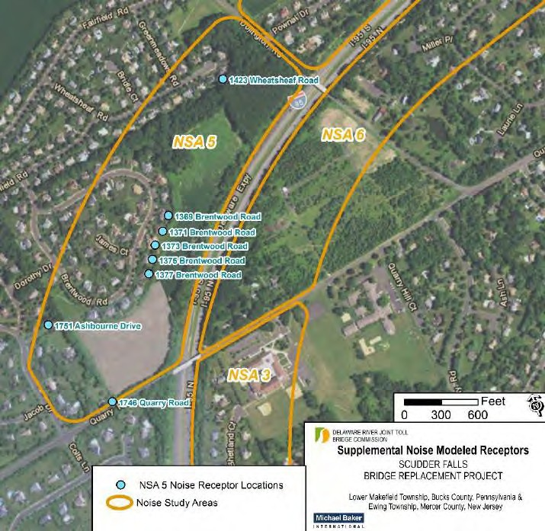
New Analysis Results
Lower Makefield Township Community Meeting
NSA 5 Modeling Results
Modeled Receptor Site Locations | Design Year Modeled Sound Level | Impact Criteria | Impact?
1379 Brentwood Road | 61 | 66 | No
1377 Brentwood Road | 59 | 66 | No
1375 Brentwood Road | 61 | 66 | No
1373 Brentwood Road | 58 | 66 | No
1371 Brentwood Road | 59 | 66 | No
1369 Brentwood Road | 60 | 66 | No
1746 Quarry Road | 61* | 66 | No
1751 Ashbourne Drive | 55 | 66 | No
1423 Wheatsheaf Road | 60 | 66 | No
*Quarry Road total sound level also influenced by Quarry Road traffic. contribution to this site is 60 dBA.
The I-95 sound level

Slide 16
New Analysis Results
Lower Makefield Township Community Meeting
NSA 6 Peak Period Measurement Data
Site | Location | AM Peak Traffic Sound Level (6-9AM) | PM Peak Traffic Sound Level (4-8PM)
1 | 1660 Quarry Road | 66 | 66
2 | 1596 Quarry Road | 55 | 59
Results for NSA 6 indicate that the peak period measurement data exceeded the previously predicted and impacted site at 1660 Quarry Road and did not approach or exceed the criteria at 1596 Quarry Road.

Slide 17
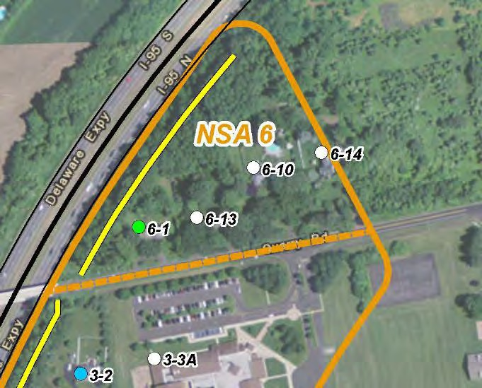
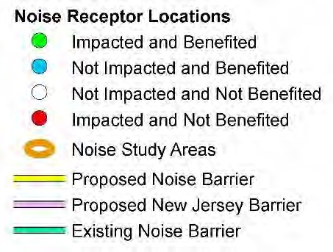
New Analysis Results
Lower Makefield Township Community Meeting
NSA 6 Modeling Results
Modeled Receptor Site Locations | Design Year Modeled Sound Level | Impact Criteria | Impact?
1660 Quarry Road (6-1) | 70 | 66 | Yes
1640 Quarry Road (6-13) | 63 | 66 | No
1620 Quarry Road (6-10) | 62 | 66 | No
1596 Quarry Road (6-14) | 60 | 66 | No
The modeling results for the residences in NSA 6 along Quarry Road indicate that the previously predicted and impacted site is still impacted and the others are below the impact criteria.

Slide 18
New Analysis Results
Lower Makefield Township Community Meeting
NSA 7 Peak Period Measurement Data
Site | Location | AM Peak Traffic Sound Level (6-9AM) | PM Peak Traffic Sound Level (4-8PM)
1 | 1505 Pownal Road | 53 | 53
2 | 1449 Bartlett Court | 53 | 54

Slide 19
New Analysis Results
Lower Makefield Township Community Meeting
NSA 7 Modeling Results
Receptor Site Location | Design Year Modeled Sound Level | Impact Criteria | Impact? |  | Receptor Site Location | Design Year Modeled Sound Level | Impact Criteria | Impact?
1513 Pownal Drive | 64 | 66 | No |  | 1515 Pownal Drive | 67 | 66 | Yes
1445 Bartlett Court | 61 | 66 | No |  | 1519 Pownal Drive | 67 | 66 | Yes
1525 Pownal Drive | 64 | 66 | No |  | 1511 Pownal Drive | 64 | 66 | No
1517 Pownal Drive | 67 | 66 | Yes |  | 1509 Pownal Drive | 62 | 66 | No
1507 Pownal Drive | 60 | 66 | No |  | 1449 Bartlett Court | 59 | 66 | No
1451 Bartlett Court | 58 | 66 | No |  | 1447 Bartlett Court | 60 | 66 | No
1521 Pownal Drive | 65 | 66 | No |  | 1446 Bartlett Court | 58 | 66 | No
1523 Pownal Drive | 65 | 66 | No
The modeling results for the residences in NSA 7 along Pownal and Bartlett indicate that the previously predicted and impacted sites are still impacted and the others are below the criteria.

Slide 20
Conclusions
Lower Makefield Township Community Meeting
The noise abatement proposed in the Environmental Assessment Technical Memo (2009) has been validated by the final design and new noise measurements and analysis.
The existing noise measurements and the new noise analysis results show that the previously impacted sites are still impacted, and the noise wall design at those locations will move forward.
The existing noise measurements and the new noise analysis results also showed that the previously non-impacted sites at NSAs 5, 6, and 7 are still not impacted and, as a result, there are no proposed additions or changes to the noise wall locations.

Slide 21
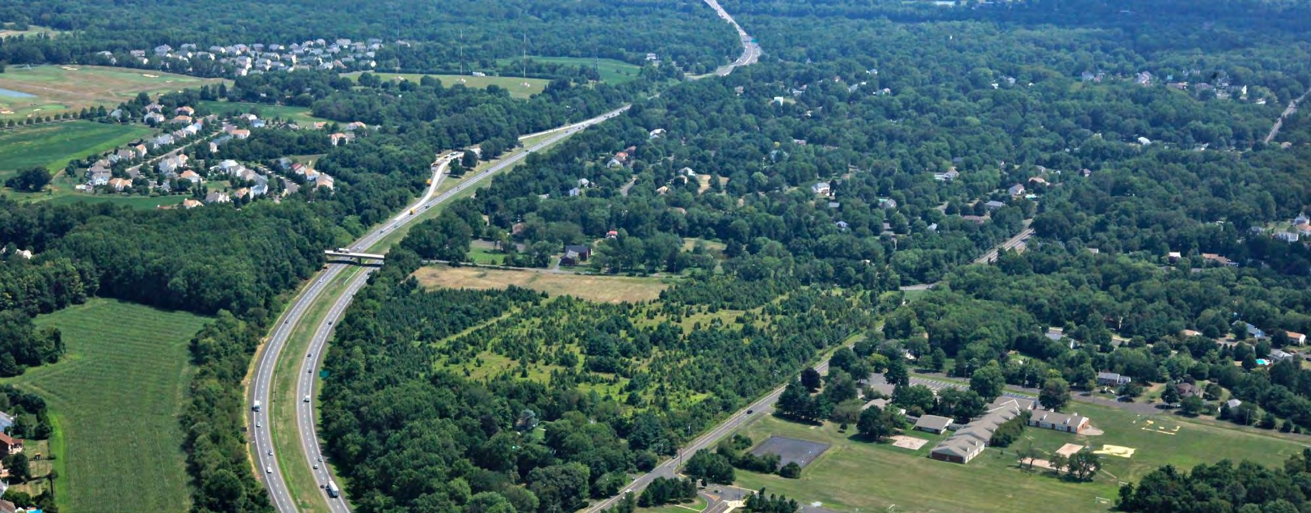
Lower Makefield Township Community Meeting
Questions and Answers

Slide 22
Lower Makefield Township Community Meeting
Supplemental Slides

Slide 23
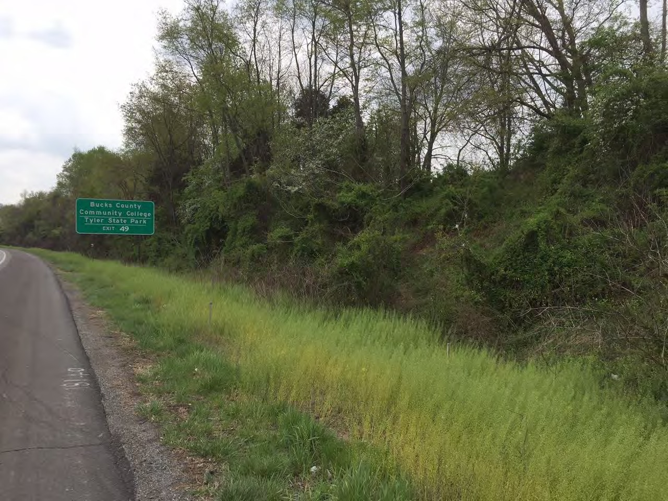
Lower Makefield Township Community Meeting

Slide 24
Lower Makefield Township Community Meeting
Existing Measured Long Term Noise Levels – 1371 Brentwood Road
Hourly Time Period | Date | Measured Sound Level | Hourly Time Period | Date | Measured Sound Level | Hourly Time Period | Date | Measured Sound Level
2 PM | 1-11-16 | 51.9 | 6 AM | 1-12-16 | 56.8 | 10 PM | 1-12-16 | 51.0
3 PM | 1-11-16 | 51.3 | 7 AM | 1-12-16 | 56.9 | 11 PM | 1-12-16 | 50.2
4 PM | 1-11-16 | 51.2 | 8 AM | 1-12-16 | 53.9 | Midnight | 1-13-16 | 48.4
5 PM | 1-11-16 | 51.7 | 9 AM | 1-12-16 | 55.3 | 1 AM | 1-13-16 | 45.5
6 PM | 1-11-16 | 50.5 | 10 AM | 1-12-16 | 57.8 | 2 AM | 1-13-16 | 46.6
7 PM | 1-11-16 | 49.4 | 11 AM | 1-12-16 | 58.6 | 3 AM | 1-13-16 | 46.7
8 PM | 1-11-16 | 49.5 | Noon | 1-12-16 | 58.5 | 4 AM | 1-13-16 | 48.4
9 PM | 1-11-16 | 50.8 | 1 PM | 1-12-16 | 58.6 | 5 AM | 1-13-16 | 51.2
10 PM | 1-11-16 | 52.0 | 2 PM | 1-12-16 | 59.4 | 6 AM | 1-13-16 | 54.0
11 PM | 1-11-16 | 52.2 | 3 PM | 1-12-16 | 57.7 | 7 AM | 1-13-16 | 55.3
Midnight | 1-12-16 | 52.1 | 4 PM | 1-12-16 | 57.0 | 8 AM | 1-13-16 | 53.8
1 AM | 1-12-16 | 51.1 | 5 PM | 1-12-16 | 61.0 | 9 AM | 1-13-16 | 53.0
2 AM | 1-12-16 | 50.8 | 6 PM | 1-12-16 | 60.6 | 10 AM | 1-13-16 | 51.5
3 AM | 1-12-16 | 51.6 | 7 PM | 1-12-16 | 57.8 | 11 AM | 1-13-16 | 50.8
4 AM | 1-12-16 | 53.0 | 8 PM | 1-12-16 | 52.0 | Noon | 1-13-16 | 52.2
5 AM | 1-12-16 | 55.9 | 9 PM | 1-12-16 | 51.0 | 1 PM | 1-13-16 | 49.0

Slide 25
Lower Makefield Township Community Meeting
Existing Measured Long Term Noise Levels – 1751 Ashbourne Road
Hourly Time Period | Date | Measured Sound Level | Hourly Time Period | Date | Measured Sound Level | Hourly Time Period | Date | Measured Sound Level
2 PM | 1-13-16 | 47 | 9 PM | 1-13-16 | 43.2 | 4 AM | 1-14-16 | 40.9
3 PM | 1-13-16 | 45.9 | 10 PM | 1-13-16 | 39.0 | 5 AM | 1-14-16 | 44.9
4 PM | 1-13-16 | 43.8 | 11 PM | 1-13-16 | 38.5 | 6 AM | 1-14-16 | 48.8
5 PM | 1-13-16 | 48.2 | Midnight | 1-14-16 | 36.1 | 7 AM | 1-14-16 | 46.7
6 PM | 1-13-16 | 47.6 | 1 AM | 1-14-16 | 37.0 | 8 AM | 1-14-16 | 47.5
7 PM | 1-13-16 | 41.5 | 2 AM | 1-14-16 | 36.4 | 9 AM | 1-14-16 | 46.8
8 PM | 1-13-16 | 40.9 | 3 AM | 1-14-16 | 37.7 | - | - | -

Slide 26
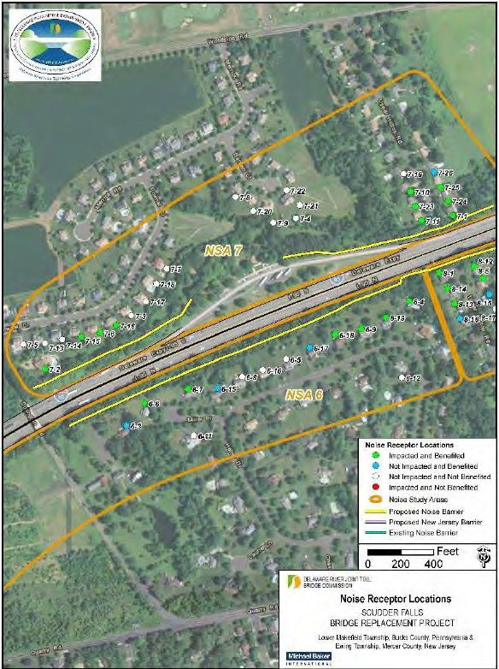
Lower Makefield Township Community Meeting
Analysis Performed in Relation to NSAs 5, 6 and 7
Final Design Assessment (2015)
Performed per updated 23 CFR 772, updated
PennDOT Publication No 24 and the DRJTBC criteria
Confirmed results of 2007 Assessment
Achieved minimum 5 dBA decrease for 50% of front
row of impact sites for NSA 6 and 7.
NSA 5 was not analyzed since 2007 study did not identify an impact and no noise abatement was proposed.

